Slide 1





AWS Solutions Architect: Associate Level
Databases
1

Slide 2







What You’ll Learn
Database Overview
Amazon RDS
Launch databases from AMIs
Uses of DynamoDB, Redshift, Aurora, and ElastiCache
DMS
AWS best practices for databases
Costs associated with databases
2

Slide 3




Databases Overview
Overview of the different types of databases available within AWS
Relational Database: In relational databases, the data is usually stored in a tabular format. Relational databases particularly use structured query language (SQL) to run queries to perform operations such as insertion, updating, deletion, and more. AWS provides following relational database services.
Amazon RDS
Amazon Redshift
Amazon Aurora
Key–Value Database: The key–value database is a type of NoSQL database where the method of having a value attached to a key is used to store data. Meaning that the data is composed of two elements, keys and values.
Amazon DynamoDB
In-memory Database: This type of database is primarily based on the main memory for computer data storage. Basically, an in-memory database keeps the whole data in the RAM. Meaning that each time you access the data, you only access the main memory and not any disk. And the reason that the main memory is faster than any disk is why in-memory databases are so popular.
Amazon ElastiCache
©Simplilearn. All rights reserved
3

Slide 4
Relational Databases
The most common form of databases are relational databases or SQL databases. They are used to store structured data.
A relational database is a collection of data items organized as a set of formally described tables. It is
also known as the relational model.
Structured Data
Unstructured Data
Relational Database
4

Slide 5
Relational Databases (Contd.)
Relational databases store data in rows and columns.
Columns
Rows
Employee Number | Surname | Forename | Sex | DOB | Salary | Section Name
EN1200 | Gilbert | Trevor | M | 20/10/1967 | 20,000 | Salary
EN1244 | Singh | Raj | M | 01/11/1971 | 15,250 | Pensions
EN1232 | MacDonald | Janet | F | 12/06/1966 | 25,000 | Pensions
EN1445 | Hussain | Khalid | M | 23/08/1982 | 17,000 | Stores
EN1653 | Varo | Linda | F | 11/03/1977 | 9,500 | IT
5

Slide 6
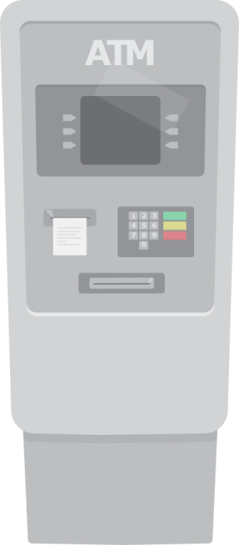
OLTP
Relational databases are mainly used for OLTP (Online Transaction Processing), which involves business
transactional processing using real time data.
An example of an OLTP database is a database that stores the transactions for an ATM.
ATM
Name | Time | Amount | Account No:
David | 11.30 AM | 500 | 12345678
6

Slide 7
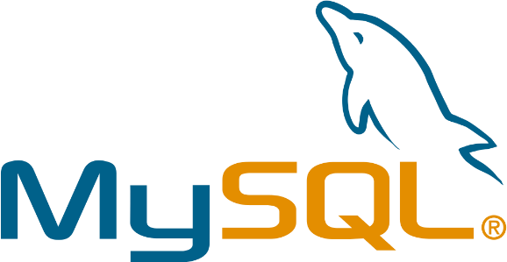


RDBMS
The most popular relational database management systems are:
7

Slide 8
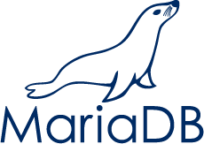


RDBMS (Contd.)
AWS offers a number of relational databases.
Aurora DB
8

Slide 9
Non-Relational Databases
Non-relational databases are referred to as NoSQL databases or Not Only SQL databases.
Structured Data
Unstructured Data
Relational Database
Non-relational Database
9

Slide 10
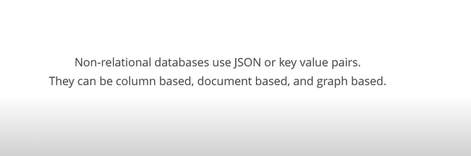
Non-Relational Databases

Slide 11
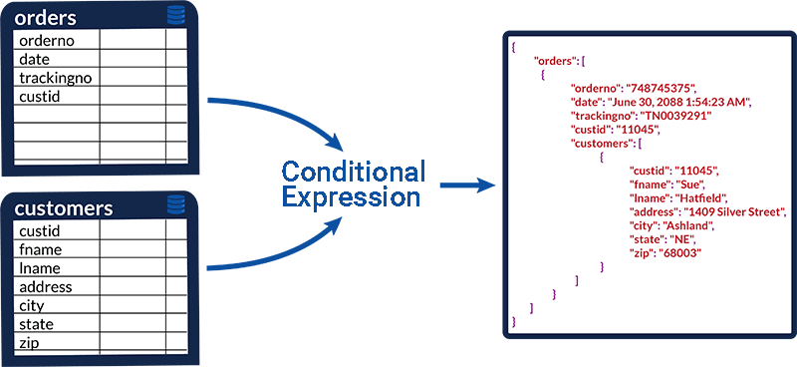
JSON

Slide 12
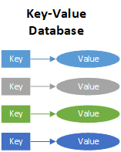

Slide 13
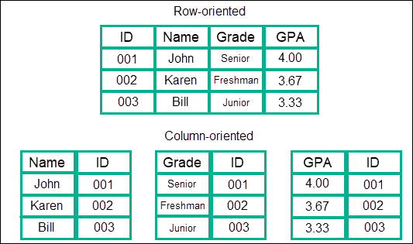

Slide 14
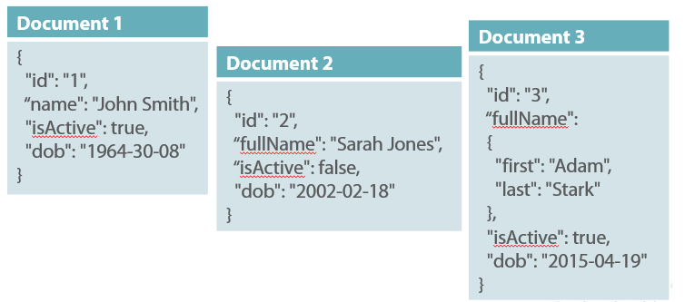
Document Based

Slide 15
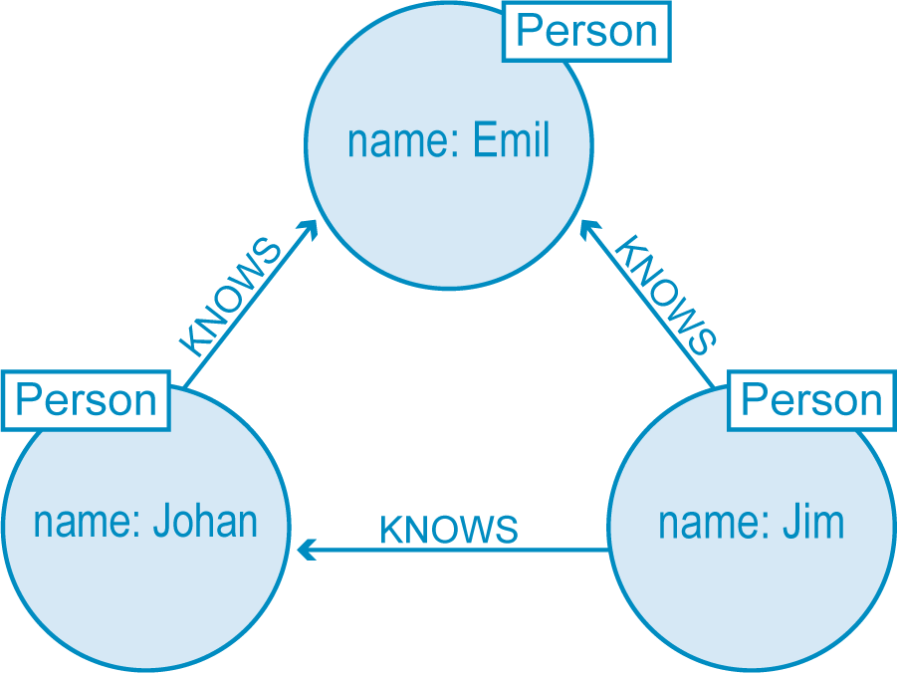
Graph Based

Slide 16


Non-Relational Databases (Contd.)
Features of non-relational databases:
Do not use relational models
Open source
Designed to run on large clusters
Do not use schema
Allow adding fields to records

Slide 17
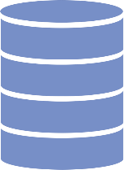
Big Data
Non-Relational Databases - Use case
NoSQL databases are commonly used where huge amounts of unstructured data need to be delivered.
Non-relational
database
Big Data

Slide 18
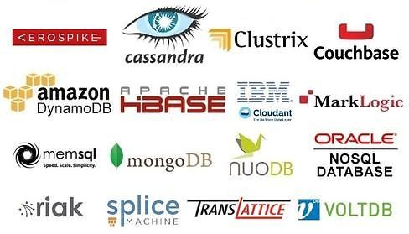
NoSQL Platforms
The most popular NoSQL databases are Cassandra, MongoDB, and CouchDB.

Slide 19
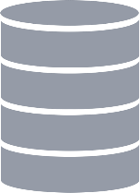
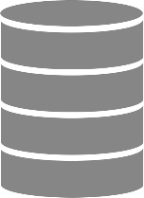
Data Warehousing
A data warehouse stores data from multiple sources for analytical purposes.
Databases

Slide 20



OLAP
Data warehouses are designed for OLAP (Online Analytics Processing), which is used to integrate copies of
transactional data from other systems and use it for analytical purposes.
Jan
Feb 2009
Time
March
North America Profit Margin % for March

Slide 21

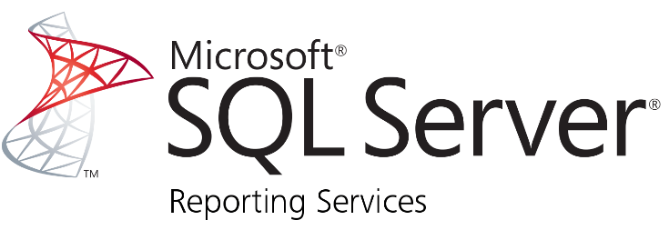


Data Warehouse Platforms
The most popular data warehouses are Cognos, SQL Server Reporting Services, and Oracle Hyperion.
Redshift

Slide 22


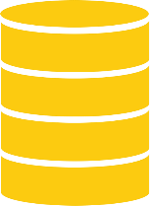


In-Memory Databases
In-memory databases are cache-based databases that store results in memory to reduce the load on your
database infrastructure and to improve user response time.
Query
Result
Result
Query Query
Query
Databases

Slide 23
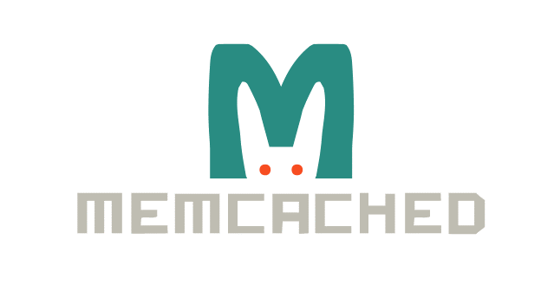
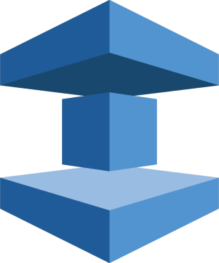

In-Memory Database Platforms
The most popular cache-based databases are MEMCACHED and Redis. AWS offers its own version called ElastiCache.
ElastiCache

Slide 24

Knowledge Check

Slide 25
KNOWLEDGE CHECK
Which are the four types of database platforms in AWS?
a.
Relational, Non-relational, Data warehouse, and In-memory
b.
Structured, Non structured, Data storehouse, and Cached
c.
Relational, Non-relational, Data storehouse, and Cached
d.
Structured, Non structured, Data Warehouse, and In-memory

Slide 26


KNOWLEDGE CHECK
Which are the four types of database platforms in AWS?
a.
Relational, Non-relational, Data warehouse, and In-memory
b.
Structured, Non structured, Data storehouse, and Cached
c.
Relational, Non-relational, Data storehouse, and Cached
d.
Structured, Non structured, Data warehouse, and In-memory
The correct answer is a)
The four types of database platforms available on AWS are Relational, Non-relational, Data
warehouse, and In-memory.

Slide 27
Amazon Relational Database Service (RDS)
Details about Amazon RDS
©Simplilearn. All rights reserved
©Simplilearn. All rights reserved
21

Slide 28
Amazon RDS
Amazon Relational Database Service (RDS) is a managed service that allows you to run databases in the AWS cloud on EC2 instances without having to worry about database administration management tasks.

Slide 29



Amazon RDS Platforms
Amazon RDS is available in Amazon Aurora, Oracle, Microsoft SQL Server, PostgreSQL, MySQL,
and MariaDB.
Aurora DB
Amazon RDS

Slide 30

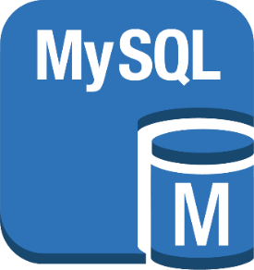

Preconfigured with Suitable Settings
RDS instances are preconfigured with a setting suitable for the type of EC2 instance you select. There is no
database installation process required.
LAUNCH
MySQL Instance
Database

Slide 31


Automated Backup
Automated backup is enabled by default. It retains both database and transaction log backups for up to 35
days for point-in-time recovery.
Relational database
Backups

Slide 32
Multi-Availability Zone Deployments
Multi-Availability Zone deployments synchronously replicate the data to a standby instance in a different
Availability Zone.
Relational Database
Standby
Replicate
Availability Zone 1
Availability Zone 2

Slide 33


Automatic Hardware Replacement
If a database instance fails due to hardware failure, RDS automatically replaces the instance with no
manual interaction required.
Instances

Slide 34

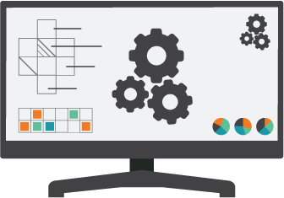
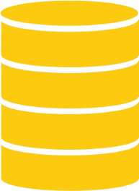

Monitoring and Metrics
Monitoring and metrics are available in CloudWatch at no extra charge; so you can monitor compute,
memory, and storage.
Memory
Compute
Storage
CloudWatch

Slide 35


Monitoring and Metrics (Contd.)
RDS offers automatic software patching to ensure that database software stays up-to-date without any
manual intervention.
Relational Database
Software Patching

Slide 36



Scalability
RDS instances can be scaled up or down in just a few minutes depending on your requirements. The
maximum size you can scale up to is 32 virtual CPUs and 244 GB of RAM.
RDS Instance
RDS Instance
RDS Instance
32 virtual CPUs and
244GB of RAM

Slide 37
Storage Increase
Some RDS instances allow you to increase the storage with zero downtime. Amazon Aurora automatically
extends the size of the database per requirement.
RDS Instance

Slide 38







Encryption
You can launch your RDS instance to encrypt your data at rest and in transit using AWS
Key Management Service (KMS).
RDS+KMS
Volume
Backup
Read Replica
Snapshot

Slide 39



Event Notifications
Database Event Notifications can be configured so you are informed via email or SMS about
database events.
Database Notification
Create Event Subscription

Slide 40



Cost Effective
As with most AWS products, you only pay for what you use. When you stop or terminate the instance, you
don't have to pay.
User
Database
User
Database

Slide 41



RDS Limitations
RDS has a few limitations. For AWS to be able to provide a fully managed solution, some of the
functionalities have to be removed.
Maintenance Plans
RAC
Database Mail
Linked Servers
Data Guard
BULK INSERT
Database Vault

Slide 42
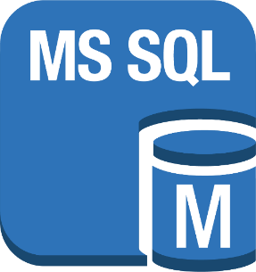
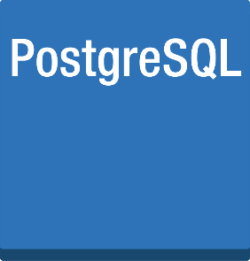
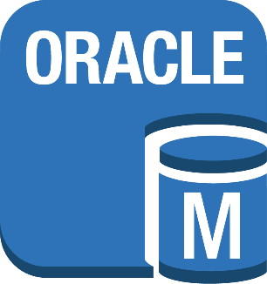
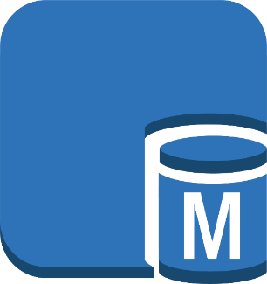


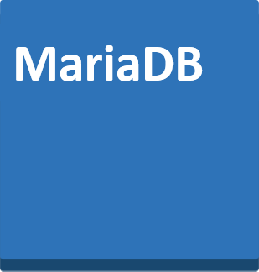
RDS Limits
You cannot use Secure Socket Shell (SSH) or Remote Desktop Protocol (RDP) with RDS instances.
Maximum RDS Volume size=6 Terabytes
SQL Server maximum RDS Volume size=4 Terabytes
20000 IOPS
30000 IOPS

Slide 43



Uses of RDS
You can use RDS in the following scenarios:
Databases that do not need full RDBMS
functionality
IT departments that do not have database expertise
Databases that require easy-to-use failover options

Slide 44


Demo 1: Amazon RDS
Demonstrate how to launch an RDS instance
©Simplilearn. All rights reserved
38

Slide 45
Knowledge Check

Slide 46
KNOWLEDGE CHECK
Which of the following platforms are available on RDS?
a.
Amazon Aurora, SAP ASE, DynamoDB, RedShift, MySQL, and MariaDB
b.
Amazon Aurora, Oracle, Microsoft SQL Server, PostgreSQL, MySQL, and MariaDB
c.
Amazon Aurora, Oracle, Microsoft SQL Server, RedShift, MySQL, and ElastiCache
d.
Amazon Aurora, Oracle, DynamoDB, PostgreSQL, MySQL, and ElastiCache

Slide 47
KNOWLEDGE CHECK
Which of the following platforms are available on RDS?
a.
Amazon Aurora, SAP ASE, DynamoDB, RedShift, MySQL, and MariaDB
b.
Amazon Aurora, Oracle, Microsoft SQL Server, PostgreSQL, MySQL, and MariaDB
c.
Amazon Aurora, Oracle, Microsoft SQL Server, RedShift, MySQL, and ElastiCache
d.
Amazon Aurora, Oracle, DynamoDB, PostgreSQL, MySQL, and ElastiCache
The correct answer is b)
Amazon RDS is available for Amazon Aurora, Oracle, Microsoft SQL Server, PostgreSQL,
MySQL, and MariaDB.

Slide 48
AMI Databases
Details of AMI database installation
©Simplilearn. All rights reserved
©Simplilearn. All rights reserved
42

Slide 49
Alternatives to RDS
In the following scenarios, you might require an alternative to RDS:
All functionalities required
1
Database expertise available
2
Required database not
available with RDS
3

Slide 50




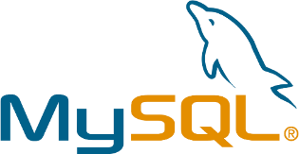




AMI Databases
When you launch an EC2 instance, there are a number of AMIs with a preinstalled database.
User
EC2
AMI

Slide 51
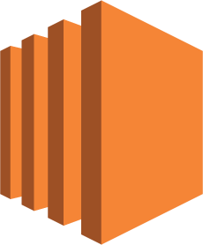





Cost and Licenses
You are charged for the cost of the EC2 instance plus a license fee for the database software on an hourly
basis.
EC2
License
Free Database Platform
Charged Database Platform

Slide 52


Manual Installation
Your alternative to AMIs is a manual installation. You can launch the EC2 instance type of your choice and
then install the database software yourself.
EC2

Slide 53
Demo 2: Launching databases from an AMI
Demonstrate how to launch a database instance using an AMI
©Simplilearn. All rights reserved
47

Slide 54
Knowledge Check

Slide 55
KNOWLEDGE CHECK
Why would you choose NOT to use RDS?
a.
To avoid the 12-36 month commitment AWS demands
b.
RDS performance is significantly slower than installing your own RDBMS
c.
Certain RDBMS functionalities are not available on RDS
d.
RDS instances take too long to launch

Slide 56
KNOWLEDGE CHECK
Why would you choose NOT to use RDS?
a.
To avoid the 12-36 month commitment AWS demands
b.
RDS performance is significantly slower than installing your own RDBMS
c.
Certain RDBMS functionalities are not available on RDS
d.
RDS instances take too long to launch
The correct answer is c)
RDS has to remove certain functionalities from the RDBMS to provide a fully managed solution. If
you need a particular functionality that is removed, then RDS is not suitable for you.

Slide 57
Amazon DynamoDB
Overview of Amazon DynamoDB
©Simplilearn. All rights reserved
©Simplilearn. All rights reserved
51

Slide 58

Amazon DynamoDB
Features of Amazon DynamoDB:
Perfect for mobile, web, gaming, and advertising technology
Fast and flexible NoSQL database
service
Fully managed NoSQL database suitable for document and key-value store models

Slide 59





Amazon DynamoDB Benefits
Benefits of Amazon DynamoDB:
Suited for read heavy applications
Always stored on SSD
Fast and flexible
High availability built-in

Slide 60
Read Consistency
DynamoDB offers two different read consistency types:
Read consistency
Eventually consistent reads
Strongly consistent reads

Slide 61
Eventually Consistent Reads
When you read data from a DynamoDB table, the response might not reflect the results of a recently completed write operation. The response might include some stale data. If you repeat your read request after a short time, the response should return the latest data.
Strongly Consistent Reads
When you request a strongly consistent read, DynamoDB returns a response with the most up-to-date data, reflecting the updates from all prior write operations that were successful. However, this consistency comes with some disadvantages:
A strongly consistent read might not be available if there is a network delay or outage. In this case, DynamoDB may return a server error (HTTP 500).
Strongly consistent reads may have higher latency than eventually consistent reads.
Strongly consistent reads are not supported on global secondary indexes.
Strongly consistent reads use more throughput capacity than eventually consistent reads

Slide 62


Provisioned Throughput Capacity
DynamoDB is charged using provisioned throughput capacity. When you create a DynamoDB table, you
can define the capacity that you want to reserve for reads and writes.
Write throughput: There is a charge per hour for every 10 units of write capacity, which can handle 36,000 writes per hour.
Read throughput: There is a charge per hour for every 50 units of read capacity, which can handle 180,000 “strongly consistent” reads or 360,000 “eventually consistent” reads per hour.
Provisioned throughput capacity

Slide 63
DynamoDB Transactions
S3 Glacier Deep Archive is a new Amazon S3 storage class that provides secure, durable object storage for long-term data retention and digital preservation.
Two new DynamoDB operations have been introduced for handling transactions:
TransactWriteItems
TransactGetItems

Slide 64
DynamoDB transactions provide developers atomicity, consistency, isolation, and durability (ACID) across one or more tables within a single AWS account and region. You can use transactions when building applications that require coordinated inserts, deletes, or updates to multiple items as part of a single logical business operation.
Two new DynamoDB operations have been introduced for handling transactions:
TransactWriteItems : a batch operation that contains a write set, with one or more PutItem, UpdateItem, and DeleteItem operations. TransactWriteItems can optionally check for prerequisite conditions that must be satisfied before making updates. These conditions may involve the same or different items than those in the write set. If any condition is not met, the transaction is rejected.
TransactGetItems : a batch operation that contains a read set, with one or more GetItem operations. If a TransactGetItems request is issued on an item that is part of an active write transaction, the read transaction is cancelled. To get the previously committed value, you can use a standard read.

Slide 65
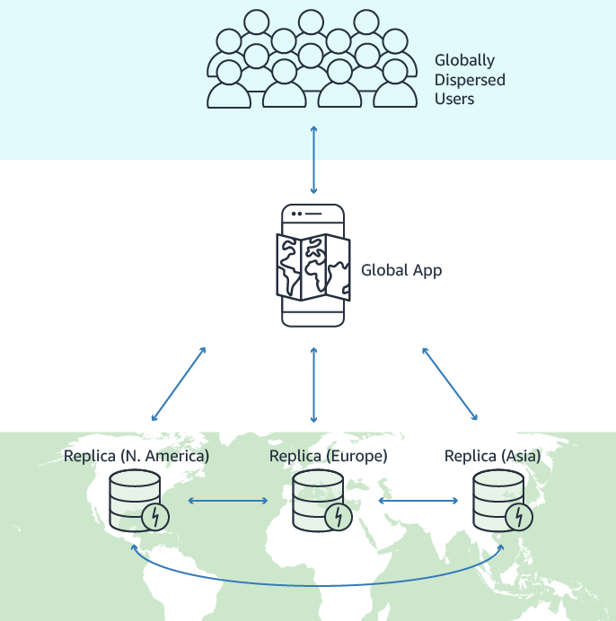
DynamoDB Global Tables
Global Tables replicate tables automatically across your choice of AWS Regions.
Multi-master replication ensures that updates performed in any region are propagated to other regions and that data in all regions is eventually consistent.

Slide 66
When you create a DynamoDB global table, it consists of multiple replica tables (one per AWS Region) that DynamoDB treats as a single unit. Every replica has the same table name and the same primary key schema. When an application writes data to a replica table in one Region, DynamoDB propagates the write to the other replica tables in the other AWS Regions automatically.

Slide 67
For example, suppose that you have a large customer base spread across three geographic areas—the US East Coast, the US West Coast, and Western Europe.
Customers can update their profile information by using your application. Without a managed replication solution, you could write code to replicate data changes among the tables for each of these Regions. However, doing this would be a time-consuming and labor-intensive effort.
Instead of writing your own code, you could create a global table referencing your three Region tables and DynamoDB would then automatically replicate data changes among those tables so that changes to one Region would seamlessly propagate to the other Regions. In addition, if one of the AWS Regions were to become temporarily unavailable, your customers could still access the same data in the other Regions.

Slide 68
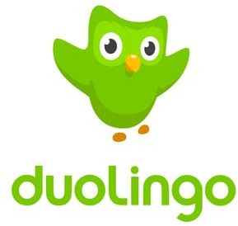


Case Study: Duolingo
Duolingo uses DynamoDB to store 31 billion items for its online learning site that delivers lessons
in 80 languages.
DynamoDB
31 billion items
80 different languages
24,000 read units/second and 3300 write
units/second

Slide 69
Demo 3: Amazon DynamoDB
Demonstrate how to use and scale DynamoDB
©Simplilearn. All rights reserved
©Simplilearn. All rights reserved
59

Slide 70
Knowledge Check

Slide 71
KNOWLEDGE CHECK
Which application type is best suited for DynamoDB?
a.
Structured data with heavy write activity
b.
Unstructured data with heavy write activity
c.
Structured data with heavy read activity
d.
Unstructured data with heavy read activity

Slide 72
KNOWLEDGE CHECK
Which application type is best suited for DynamoDB?
a.
Structured data with heavy write activity
b.
Unstructured data with heavy write activity
c.
Structured data with heavy read activity
d.
Unstructured data with heavy read activity
The correct answer is d)
DynamoDB is a NoSQL database best suited for applications with heavy read and low write activity.

Slide 73
Amazon Redshift
Overview of Amazon Redshift
©Simplilearn. All rights reserved
©Simplilearn. All rights reserved
63

Slide 74
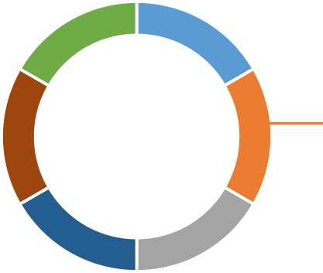

Amazon Redshift
Features of Amazon Redshift:
Compatible with your existing business tools
6
1
Fast
Cost-effective
5
2
Fully managed
Simple
4
3
Petabyte-scale data warehouse

Slide 75
OLAP and Columns
Redshift is a column-based database designed for OLAP that allows you to combine multiple complex queries
to provide answers.
Country | Product | Sales
India | Chocolate | 1000
India | Ice-cream | 2000
Germany | Chocolate | 4000
US | Noodles | 500
Row Store
Column Store
India
Chocolate
1000
India
Ice-cream
2000
Germany
Chocolate
4000
US
Noodle
500
India
India
Germany
US
Chocolate
Ice-cream
Chocolate
Noodle
1000
2000
4000
500
Row 1
Country
Row 2
Product
Row 3
Sales
Row 4

Slide 76
Columnar Storage
Columnar data is stored sequentially in the storage. It requires less reads to get all the data.
Column Store
Row Store
India
India
Germany
US
Chocolate
Ice-cream
Chocolate
Noodle
1000
2000
4000
500
India
Chocolate
1000
India
Ice-cream
2000
Germany
Chocolate
4000
US
Noodle
500
Column Based
Row Based

Slide 77



Nodes
An Amazon Redshift data warehouse is a collection of computing resources called nodes. Nodes are organized into a group called a cluster. Each cluster runs in Amazon Redshift engine that contains one or more databases.
Nodes
Redshift Warehouse
Cluster
Redshift Engine
160 GB
160 GB
160 GB
160 GB
160 GB
Nodes Nodes Nodes
Massive Parallel Processing
Nodes Nodes
Total 128 Nodes
Leader Node

Slide 78


Limitation
Redshift does not have high availability as it is available only in one availability zone.
Redshift Snapshot
Availability Zone
Redshift
Availability Zone
Redshift Snapshot
Availability Zone

Slide 79

Redshift Costs
Cost associated with Redshift:
Data transfers in your VPC
Number of compute node hours
Backups

Slide 80
Knowledge Check

Slide 81
KNOWLEDGE CHECK
Which of the following is NOT a benefit of Redshift?
a.
Ability to reduce storage costs
b.
Requires less reads to get data from storage
c.
Provides high availability
d.
Ability to process OLAP queries quickly and efficiently

Slide 82
KNOWLEDGE CHECK
Which of the following is NOT a benefit of Redshift?
a.
Ability to reduce storage costs
b.
Requires less reads to get data from storage
c.
Provides high availability
d.
Ability to process OLAP queries quickly and efficiently
The correct answer is c)
Redshift is not designed for high availability as it is only available in one Availability Zone.

Slide 83
Amazon ElastiCache
Overview of Amazon ElastiCache
©Simplilearn. All rights reserved
©Simplilearn. All rights reserved
73

Slide 84
ElastiCache is a distributed cache environment for providing faster access to data by using cloud-based caching. Querying for data directly from databases or through remote API calls is much slower than querying the data from cache. AWS provides ElastiCache service which has high performance, scalability and cost-effectiveness. It removes the complexities associated with managing a distributed cache.

Slide 85

Amazon ElastiCache Overview
Features of Amazon ElastiCache:
Easy to operate
2
Easy to deploy
1
3
Easy to scale an in-memory cache
ElastiCache

Slide 86



Cached Query Results
ElastiCache caches can store input/output-intensive database query results or compute-intensive calculations.
Query
Result
Query
Result
Result
Query
Database

Slide 87

Amazon ElastiCache Benefits
Benefits of Amazon ElastiCache:
Good for read-heavy databases as it reduces the load
Better throughput
Right for compute-intensive workloads
Improves latency

Slide 88



Memcached and Redis
Amazon ElastiCache supports both Memcached and Redis, which are open source in-memory caching engines.
ElastiCache
Open source
in-memory caching engines
Memcached
Redis

Slide 89
Using Redis
The below list of features show how Redis is capable of handling more complex data structures, provide persistence and sorting etc. So the scenarios under which we should favour Redis as the platfrom in ElastiCache are described here.
Need to store complex data types, such as strings, hashes, lists, sets, sorted sets, and bitmaps.
Need to sort or rank in-memory datasets.
Need persistence of your key store.
Need to replicate your data from the primary to one or more read replicas for read intensive applications.
Need automatic failover if your primary node fails.
Need automatic failover if your primary node fails.
Need backup and restore capabilities.
Need to support multiple databases.
Using Memcached
Memcached is more suitable for simpler data structures and does not provide persistence. So the below scenarios are appropriate for Memcached use.
Need the simplest data model possible to store Key-Value pairs.
Need to run large nodes with multiple cores or threads
Need the ability to scale out and in, adding and removing nodes as demand on your system increases and decreases.
Need to cache objects, such as a database.

Slide 90
Knowledge Check

Slide 91
KNOWLEDGE CHECK
Which type of application is ElastiCache suitable for?
a.
Write heavy with low read activity
b.
Read heavy with low write activity
c.
Read heavy with high write activity
d.
Write heavy with high read activity

Slide 92
KNOWLEDGE CHECK
Which type of application is ElastiCache suitable for?
a.
Write heavy with low read activity
b.
Read heavy with low write activity
c.
Read heavy with high write activity
d.
Write heavy with high read activity
The correct answer is b)
ElastiCache is suitable for applications that are read heavy with low write activity so users’ queries
can be cached for future use.

Slide 93
Amazon Aurora
Overview of Amazon Aurora
©Simplilearn. All rights reserved
©Simplilearn. All rights reserved
81

Slide 94

Amazon Aurora Overview
Amazon Aurora is a relational database engine compatible with MySQL and Postgres. It combines the speed and availability of high-end commercial databases with the simplicity and
cost-effectiveness of open source databases.
Amazon Aurora runs only on AWS.

Slide 95

Amazon Aurora Benefits
Benefits of Amazon Aurora:
MySQL-compatible relational database
5X performance of MySQL
Secure, available, and reliable as Oracle
Cost effective

Slide 96



Amazon Aurora Architecture
Amazon Aurora architecture starts with a 10 GB database that scales in 10 GB increments up to 64 TB. You
can scale instance size up to 32 virtual CPUs and 244 GB of memory.
Auto scales
Auto scales
10 GB
10 GB
Increments
64 TB
Scale up to 32 virtual CPUs and 244 GBs of memory
The auto scaling process takes a couple of minutes as it is not instant.

Slide 97
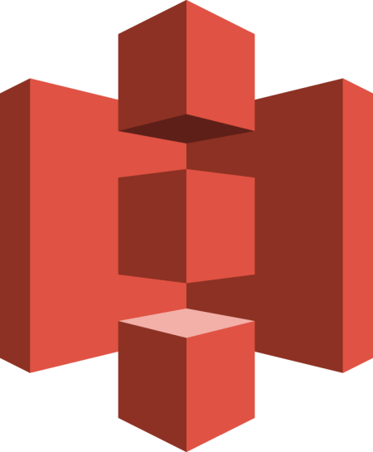
Amazon Aurora Architecture (Contd.)
Aurora offers high-availability. It maintains six copies of data that are replicated across three
Availability Zones.
Aurora
Aurora
Aurora
Availability Zone
Availability Zone
Availability Zone
©Simplilearn. All rights reserved
Am8a5zon S3

Slide 98


Amazon Aurora Replicas
Amazon Aurora creates up to 15 Aurora read replicas and up to five MySQL read replicas that can be created
using MySQL replication.
Aurora
5 MySQL Read
Replicas
New Aurora DB Instance
15 Aurora Read
Replicas

Slide 99
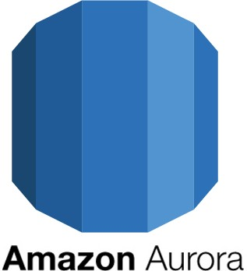

Aurora Multi Master
Aurora Multi-Master allows you to create multiple read/write master instances across multiple
Availability Zones.

Slide 100

Aurora Serverless
Aurora Serverless is a database that only runs when you need it. It is suitable for infrequent or unpredictable workloads and scales automatically.
There is no need to manage instances of clusters.

Slide 101
Knowledge Check

Slide 102
KNOWLEDGE CHECK
Amazon Aurora maintains:
a.
6 copies in 2 Availability Zones
b.
3 copies in 3 Availability Zones
c.
9 copies in 3 Availability Zones
d.
6 copies in 3 Availability Zones

Slide 103
KNOWLEDGE CHECK
Amazon Aurora maintains:
a.
6 copies in 2 Availability Zones
b.
3 copies in 3 Availability Zones
c.
9 copies in 3 Availability Zones
d.
6 copies in 3 Availability Zones
The correct answer is d)
Amazon Aurora maintains 6 copies of data, which are replicated across three Availability Zones.

Slide 104
AWS Database Migration Services (DMS)
Overview of AWS DMS
©Simplilearn. All rights reserved
©Simplilearn. All rights reserved
92

Slide 105
AWS DMS Overview
According to Amazon, “AWS Database Migration Service allows you to migrate
your databases to AWS infrastructure with minimal downtime.”

Slide 106
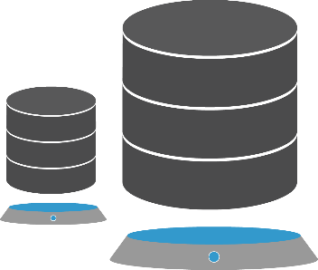

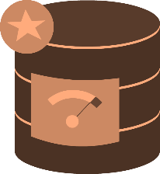

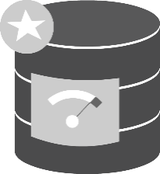
Homogenous Migrations
You can perform homogenous migrations, such as Oracle to Oracle or MySQL to Amazon Aurora.
Source: Oracle Database
on-premises, in EC2 or RDS
AWS Database
Migration Service
Target: RDS for
Oracle Database
Source: MySQL Database
on-premises, in EC2 or RDS
AWS Database
Migration Service
Target: Amazon
Aurora Database

Slide 107
Heterogeneous Migrations
Using the AWS Schema Conversion Tool, you can perform heterogeneous migrations between different RDBMS.
Source Database | Target Database
Microsoft SQL Server | Amazon Aurora, MySQL, PostgreSQL, MariaDB
MySQL and MariaDB | PostgreSQL
Oracle | Amazon Aurora, MySQL, PostgreSQL, MariaDB
PostgreSQL | Amazon Aurora, MySQL, MariaDB
Amazon Aurora | PostgreSQL

Slide 108

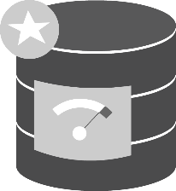
AWS Schema Conversion Tool
The Schema Conversion Tool is a two step conversion process:
STEP 1:
Source: Oracle Database
on-premises, in EC2 or RDS
AWS Schema Conversion Tool
Target: Amazon
Aurora Database
STEP 2:
Source: Oracle Database on-premises, in EC2 or RDS
AWS Database Migration Service
Target: Amazon Aurora Database

Slide 109
AWS Schema Conversion Tool (Contd.)
DMS has the ability to stream data from any supported database source to Aurora or Redshift so you can easily
consolidate your data or create a data warehouse.
AWS Database Migration Service
Target: Amazon Aurora Database
Source: Multiple
MySQL Databases
on-premises, in EC2 or RDS

Slide 110
Knowledge Check

Slide 111
KNOWLEDGE CHECK
Which of the following two types of migration does AWS DMS support?
a.
Heterogeneous and Homogenous
b.
Transactional and Replication
c.
Synchronous and Asynchronous
d.
Transient and Migratory

Slide 112
KNOWLEDGE CHECK
Which of the following two types of migration does AWS DMS support?
a.
Heterogeneous and Homogenous
b.
Transactional and Replication
c.
Synchronous and Asynchronous
d.
Transient and Migratory
The correct answer is a)
AWS DMS supports Heterogeneous and Homogenous migration.
100

Slide 113
Database Best Practices
Overview of AWS recommended database best practices
©Simplilearn. All rights reserved
©Simplilearn. All rights reserved
101

Slide 114
RDS
RDS
Use Amazon RDS instances to automatically provide a fully managed
RDBMS with the following benefits:
Built-in redundancy between Availability Zones
Automatic backups
Automatic patching and updates
OLTP
NoSQL
Data Warehousing and OLAP
114

Slide 115
OLTP
RDS
For OLTP applications, use DynamoDB or RDS with provisioned IOPS.
OLTP
NoSQL
Data Warehousing and OLAP
115

Slide 116
NoSQL
RDS
For NoSQL databases, use DynamoDB as it is a fast and flexible
database service.
OLTP
NoSQL
Data Warehousing and OLAP
116

Slide 117
Data Warehousing and OLAP
RDS
For Data Warehousing and OLAP, use Amazon Redshift.
OLTP
NoSQL
Data Warehousing and OLAP
117

Slide 118
In-Memory
In-memory
For In-memory or caching database requirements, use Amazon
ElastiCache.
Migration
118

Slide 119
Migration
In-memory
When migrating your databases to AWS, use the AWS Database Migration Services. Check if you can reduce your database costs by migrating to a lower cost RDBMS.
Migration
119

Slide 120
Database Costs
Overview of costs associated with AWS databases
©Simplilearn. All rights reserved
108

Slide 121
Database Costs
The following costs are associated with the AWS databases:
Amazon RDS:
Cost per hour depending on the instance size and RDBMS licensing cost (if required)
Per GB cost for storage
Amazon DynamoDB:
Write Throughput: fee per hour for every 10 units of Write Capacity
Read Throughput: fee per hour for every 50 units of Read Capacity
Per GB fee for indexed storage
Fee for DynamoDB streams
Data transfer out fee
Amazon Redshift:
Cost per hour depending on the instance size
121

Slide 122
Database Costs (Contd.)
The following costs are associated with the AWS databases:
Amazon Elasticache:
Cost per hour depending on the cache size selected
Data transfer cost between EC2 instances and Elasticache in different AZs
AWS Database Migration Services:
Cost per hour for the compute resources used during migration
Data transfer out to the Internet
122

Slide 123
Key Takeaways
©Simplilearn. All rights reserved
111

Slide 124
Key Takeaways
RDS allows you to run databases in the AWS cloud on EC2 instances without worrying about database
administration management tasks.
In situations where RDS isn’t suitable, you can launch an EC2 instance from AMIs with
pre-installed databases.
Amazon DynamoDB is a fast and flexible NoSQL database service for all applications that need consistent, single-digit millisecond latency at any scale.
Amazon Redshift is a fast, fully managed, petabyte-scale data warehouse that makes it simple and cost-effective to analyze all your data using your existing business intelligence tools.
ElastiCache is an AWS service that makes it easy to deploy, operate, and scale an in-memory cache in the cloud.
Amazon Aurora is a relational database engine compatible with MySQL and Postgres. It combines the speed and availability of high-end commercial databases with the simplicity and cost-effectiveness of open source databases.
AWS Database Migration Service allows you to migrate your databases to AWS infrastructure with minimal downtime.
112

Slide 125
Practice Assignment: Amazon RDS
Launch an Amazon RDS instance and connect to a webserver
©Simplilearn. All rights reserved
113

Slide 126

Launch Amazon RDS Instance
Your company wants to use an RDS instance as the data repository
for their webserver.
You will need to complete the following tasks:
Create an additional private subnet in your custom VPC.
Verify the inbound rules for your DBSERVER security group.
Create a DB Subnet Group to host your RDS instance.
Launch a MySQL RDS instance into the DB subnet group.
Launch a new webserver into a public subnet of your custom VPC.
Configure connectivity between the webserver and the RDS instance.
You can use demonstration one from this lesson as a reference for this Practice Assignment.
126

Slide 127

Quiz
127

Slide 128

QUIZ 1
What is the charge when replicating data between your primary and secondary RDS instances?
a.
The AWS standard charge
b.
Half the AWS standard charge
c.
Depends on the amount of data transferred
d.
No charge; it's free
128

Slide 129
QUIZ 1
What is the charge when replicating data between your primary and secondary RDS instances?
a.
The AWS standard charge
b.
Half the AWS standard charge
c.
Depends on the amount of data transferred
d.
No charge; it's free
The correct answer is d
Explanations: RDS synchronously replicates your data to a standby instance in a different Availability zone for free.
129

Slide 130
QUIZ 2
Which AWS service is most suitable for non-relational databases?
a.
ElastiCache
b.
DynamoDB
c.
RDS
d.
EC2
130

Slide 131
QUIZ 2
Which AWS service is most suitable for non-relational databases?
a.
ElastiCache
b.
DynamoDB
c.
RDS
d.
EC2
The correct answer is b
Explanations: DynamoDB is a NoSQL database that is best suited for non-relational databases.
131

Slide 132
QUIZ 3
What is the maximum-sized RDS volume you can have for MySQL and Oracle?
a.
6TB
b.
4TB
c.
2TB
d.
3TB
132

Slide 133
QUIZ 3
What is the maximum-sized RDS volume you can have for MySQL and Oracle?
a.
6TB
b.
4TB
c.
2TB
d.
3TB
The correct answer is a
Explanations: MySQL, PostgreSQL, and Oracle RDS instances are limited to 6TB in size. For SQL Server, it is 4TB, and
for SQL Server Express, it is 300GB.
133

Slide 134
QUIZ 4
What is the maximum IOPS capacity of an Oracle and MySQL RDS instance?
a.
10,000 IOPS
b.
20,000 IOPS
c.
30,000 IOPS
d.
50,000 IOPS
134

Slide 135
QUIZ 4
What is the maximum IOPS capacity of an Oracle and MySQL RDS instance?
a.
10,000 IOPS
b.
20,000 IOPS
c.
30,000 IOPS
d.
50,000 IOPS
The correct answer is c
Explanations: MySQL, MariaDB, PostgreSQL, and Oracle RDS instances have a maximum of 30000 IOPS. SQL Server
has a maximum of 20,000 IOPS.
135

Slide 136
QUIZ 5
Which of the following ports needs to be open to use RDP to a SQL Server RDS instance?
a.
3389
b.
1433
c.
22
d.
You cannot RDP to an RDS instance
136

Slide 137
QUIZ 5
Which of the following ports needs to be open to use RDP to a SQL Server RDS instance?
a.
3389
b.
1433
c.
22
d.
You cannot RDP to an RDS instance
The correct answer is d
Explanations: You cannot use RDP (or SSH) to RDS instances.
137

Slide 138





This concludes “Databases.”
The next lesson is “Application Services.”
©Simplilearn. All rights reserved
©Simplilearn. All rights reserved
126

